Slide 1
Getting To The
Heart
Strengthening
Team
Communication
Notes:
Introduce self, describe LMC, 15+ yrs of primary care delivery in the safety net.

Slide 2
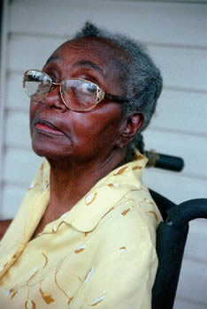
Primary care is not for the faint of heart
Notes:
Shawn story – mid Friday afternoon, new pt, brittle DM, foot wound, mult prior ER visits, chronic pain from old back injuries. Before and after.

Slide 3
Team-Based Care
1:1 MA-Provider ratio
Dedicated huddle time
Huddle process
MA-Provider communication must be robust, effective, efficient

Slide 4
Team transformation takes work
Not easy to make the changes as outlined above.
Providers and MAs are often thrown together and do not have time to learn how they can work well together.
Getting to the Heart is our answer to this problem.

Slide 5
Sometimes our reality is not so pretty
“She has no work ethic.”
“If only that doctor could learn where to look for supplies!”
“I know she tossed the mammo referral.”
“That provider needs to take her meds!”
“Does she think that she can just yell across the room at me?”
Notes:
Trina and I do our thing. We can note that we developed G2H by driving to Eastmont.

Slide 6
Getting to the Heart -- Goal
To promote and support highly effective team-based care, specifically through improved MA-Provider communication

Slide 7
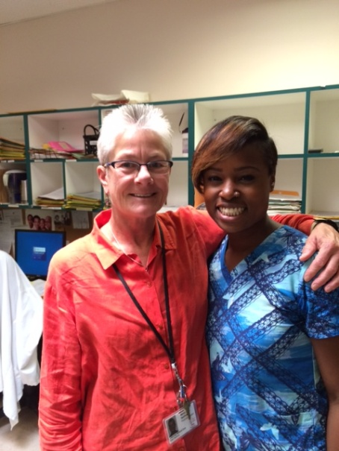
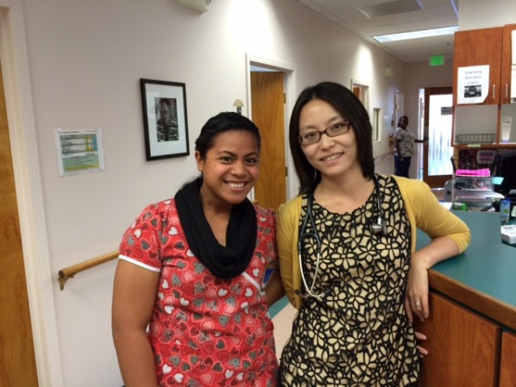
Talk, Eat, Problem Solve.
Notes:
Describe the project – six weeks of conversations, paid lunch hour and food…. Develop the relationships needed to work collaboratively. Processes can be put in place, but relationships must be built for the work to truly have heart.

Slide 8
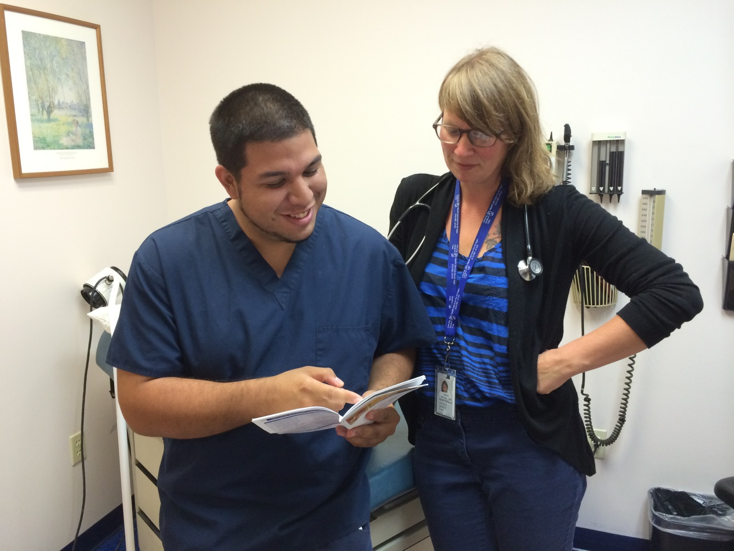
Getting to the Heart

Slide 9
The Guidebook

Slide 10
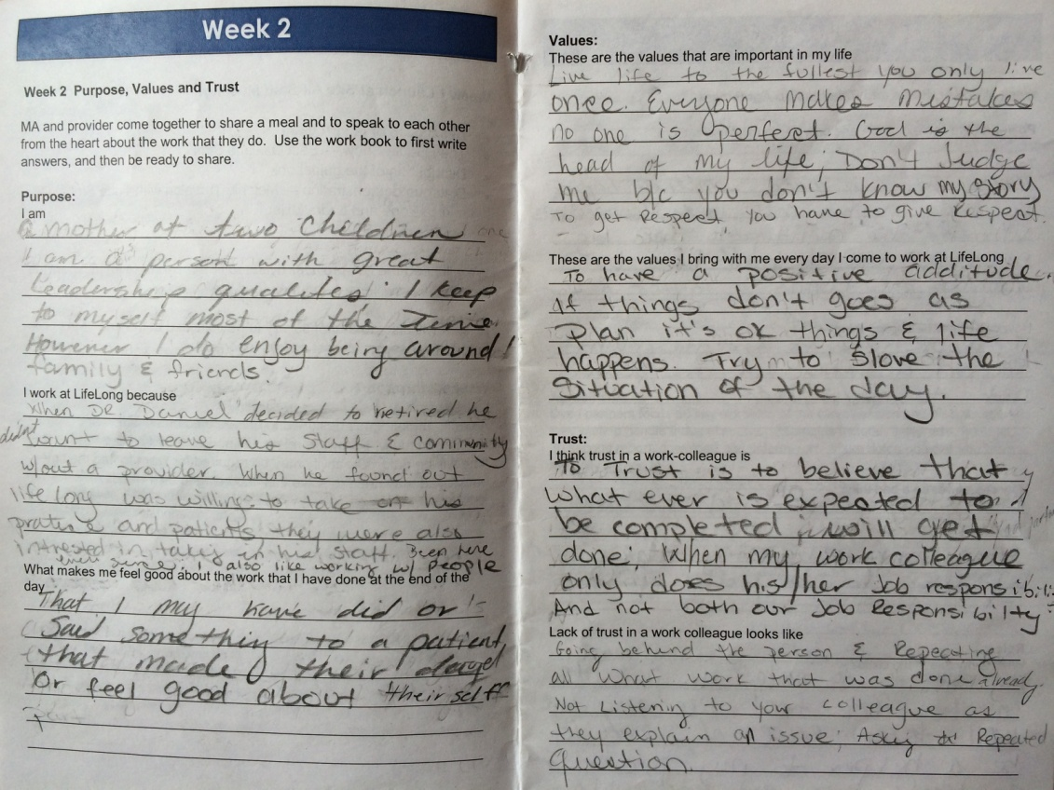
Week One – Introduction
Introduction to Getting to the Heart
Brainstorm logistics.
Distribute the guidebook

Slide 11
Week Two – Purpose, Values, Trust.
Purpose:
I am
I work at this clinic because
What makes me feel good about my work
Values:
These values are important to me
I bring these values to work
Trust:
I think trust in a work colleague is
Lack of trust looks like

Slide 12
Week Three – Power, Roles and Agreements
Power:
To me power is…
How can power be a good thing?
How can power be a bad thing?
Roles:
What is my role in the clinic?
What are the duties that you may have that your dyad partner may not know about?
How do you see the role of your dyad partner?

Slide 13
Week Three – Power, Roles and Agreements
Agreements:
Timeliness
Huddles
In-clinic communication
The Unforeseen
Visit prep
?????

Slide 14
Week Four
What have I learned?
How I want to move forward?
As a dyad we have learned?
As a dyad we want to move forward with?
What do we want to share at the mid-point review next week?

Slide 15
Mid Point Review
Review of the process and progress to date.
Facilitated by staff – look to your local leaders.

Slide 16
Weeks Five, Six and Seven – Case Review
What went well?
What needed to be done differently?
How did trust show up?
How did our agreements make themselves evident?
Did we learn something new that we need to incorporate?

Slide 17
Week Eight
Dyads present their best practices.
Dyads develop a model for continued learning.

Slide 18
Getting to the Heart Outcomes
Increased access to care by increasing productivity
Positive return on investment
Improved patient and staff experience

Slide 19
Increased productivity
Notes:
Explain axes. Despite roll out of EHR,

Slide 20
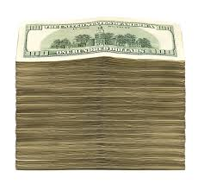
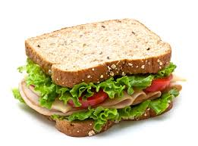
Financially Viable
279K
99K
32K
Train the trainer model
Getting to the Heart
one visit removed
Actual project

Slide 21
Return on Investment

Slide 22
Patient Experience
Notes:
Survey done 6 months after intervention in one clinic. High satisfaction. 78% rated 8 or above. Interestingly, 42% said they noted a difference while 57 % had not noted a difference,

Slide 23
Patients say:
It makes you happy. It makes you feel good, it makes me comfortable to be able to come into an atmosphere of love and understanding. To see that the doctor and the assistant are working together with their patient.

Slide 24
Staff experience
Most frequent words: trust and respect.
Improved communication from learning the partner’s background.
Perceived impact: increased productivity.
Future opportunities: non-provider to document history, more chart prep to give more time for verbal communication.

Slide 25
Staff says
Getting to the Heart forced us to talk. It is bonding, it’s not like working with a blank canvas.
I will trust my partner (MA) more, less questioning, allow her to take more responsibility.

Slide 26
Challenges
Time to have the conversations.
Logistics surrounding the lunch gift certificates.
Potential for conflict to surface -- willing mediators needed.

Slide 27
Getting to the Heart Lessons Learned
Power dynamic in the MA-provider relationship must be named
Processes must be put in place, but relationship remains key to patient experience of care

Slide 28
Getting to the Heart Lessons Learned
MA-Provider respect and trust are paramount
It is better to buy lunch than lose patient visits

Slide 29
Getting to the Heart Future Directions
In use at LifeLong Medical in Oakland and Berkeley and at Maxine Hall Clinic in San Francisco.
Contact Laura Miller, MD for technical assistance in launching Getting to the Heart. lmiller@chcnetwork.org

Slide 30
Thank you!
Please let us know
what you discover!

